Slide 1
Heart Attack Risk 🩺 Predictive Analysis

Slide 2


Meet our team
Sri Sai Durga Myneni
Rachana Chinthanippu​

Slide 3


Agenda
A
Introduction
Problem statement
Symptoms of Heart attack
CRISP Methodology
Tools
Dataset
Machine Learning Algorithms
Summary

Slide 4
Introduction
Heart attack prediction is one of the serious causes of morbidity in the world’s population. The clinical data analysis includes a very crucial disease i.e., cardiovascular. Data Science and machine learning (ML) can be very helpful in the prediction of heart attacks in which different risk factors like high blood pressure, high cholesterol, abnormal pulse rate, diabetes, etc... can be considered.

Slide 5
Problem Statement
Given the clinical parameters about the patients, can we predict whether or not they have heart disease?

Slide 6
Heart disease or cardiovascular disease is one of the biggest reason for death across the globe. As it is a cause of 35% of total death worldwide.so, if somehow we manage to find the risk of someone having a heart disease beforehand then it would be helpful.

Slide 7

Introduction
Heart attack prediction is one of the serious causes of morbidity in the world’s population. The clinical data analysis includes a very crucial disease i.e., cardiovascular. Data Science and machine learning (ML) can be very helpful in the prediction of heart attacks in which different risk factors like high blood pressure, high cholesterol, abnormal pulse rate, diabetes, etc... can be considered.

Slide 8
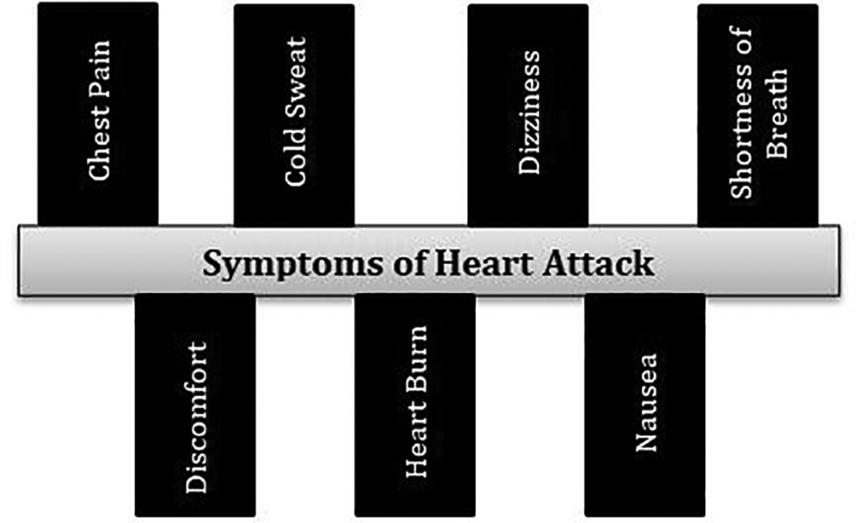
Areas of focus
Symptoms of a Heart attack
F
Cloud-based opportunities
Iterative approaches to corporate strategy
Establish a management framework from the inside

Slide 9
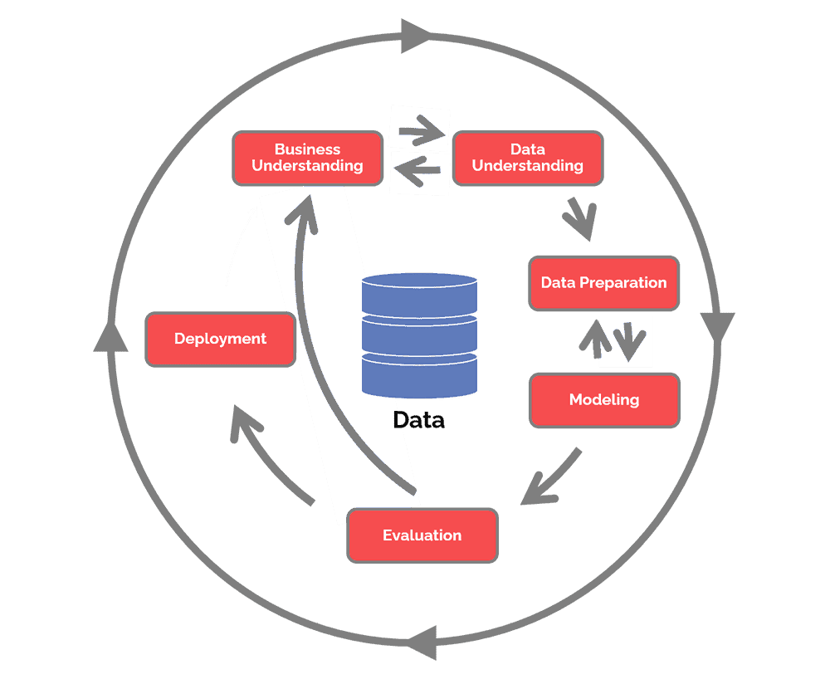
CRISP Methodology

Slide 10
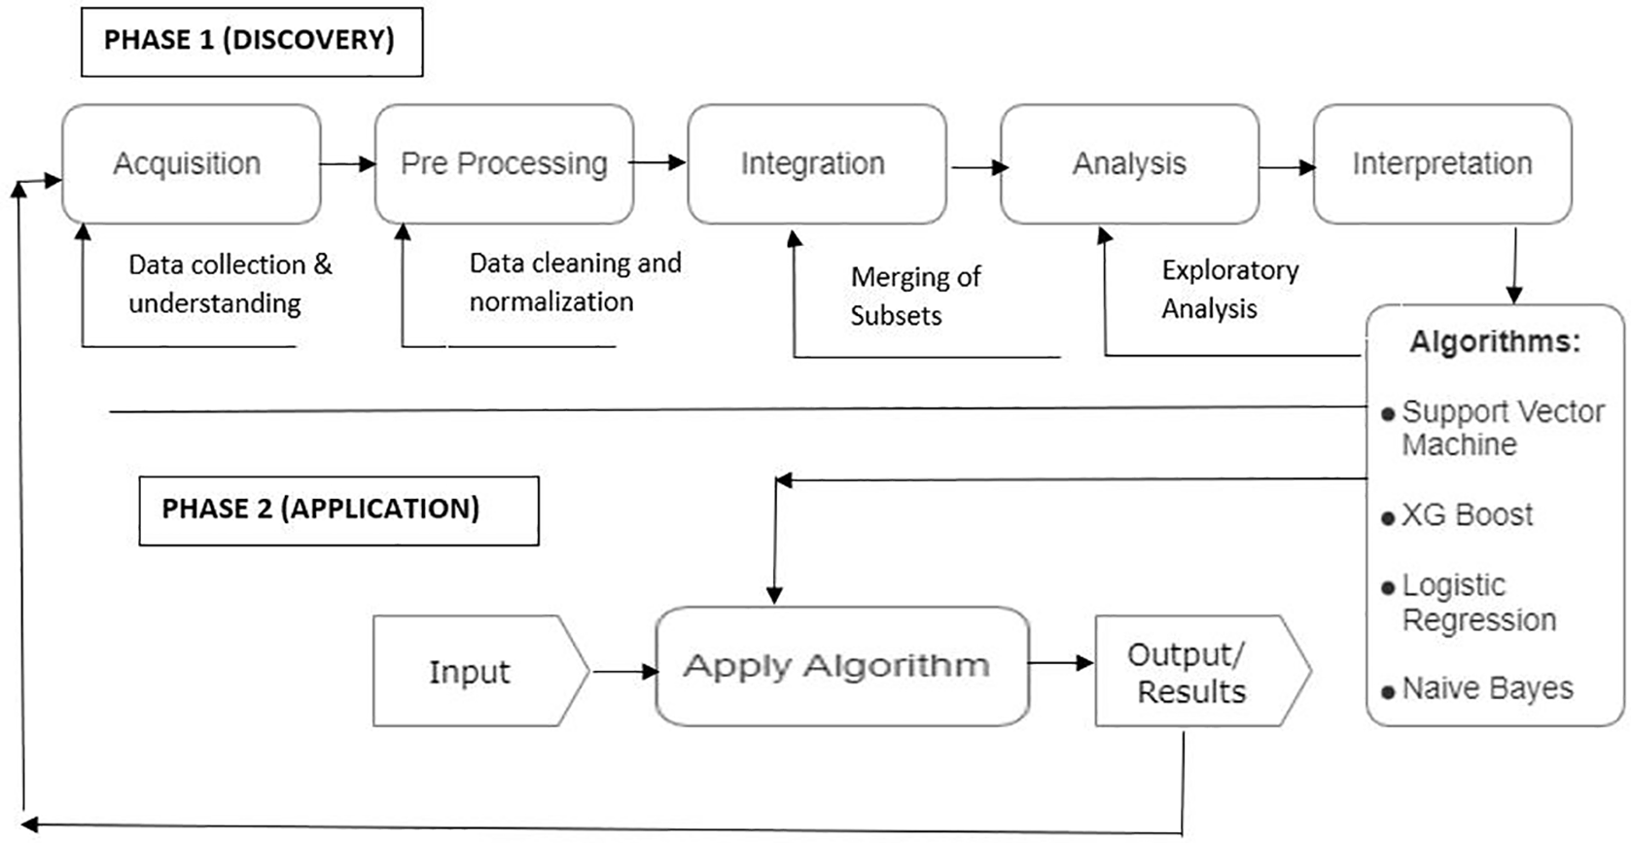
Approach Flowchart
ROI
Niche markets
Supply chains
Envision multimedia-based expertise and cross-media growth strategies
Visualize quality intellectual capital
Engage worldwide methodologies with web-enabled technologies
Pursue scalable customer service through sustainable strategies
Engage top-line web services with cutting-edge deliverables
Cultivate one-to-one customer service with robust ideas
Maximize timely deliverables for real-time schemas

Slide 11
Tools
Gathering Data
Kaggle
Refining Data
Exploratory Data Analysis
Matplotlib
Python
Data Modeling
Python Pandas
Seaborn
Scipy
Scikit
Model Evaluation
Python
Scikit
Deployment
Microsoft Azure
Docker

Slide 12
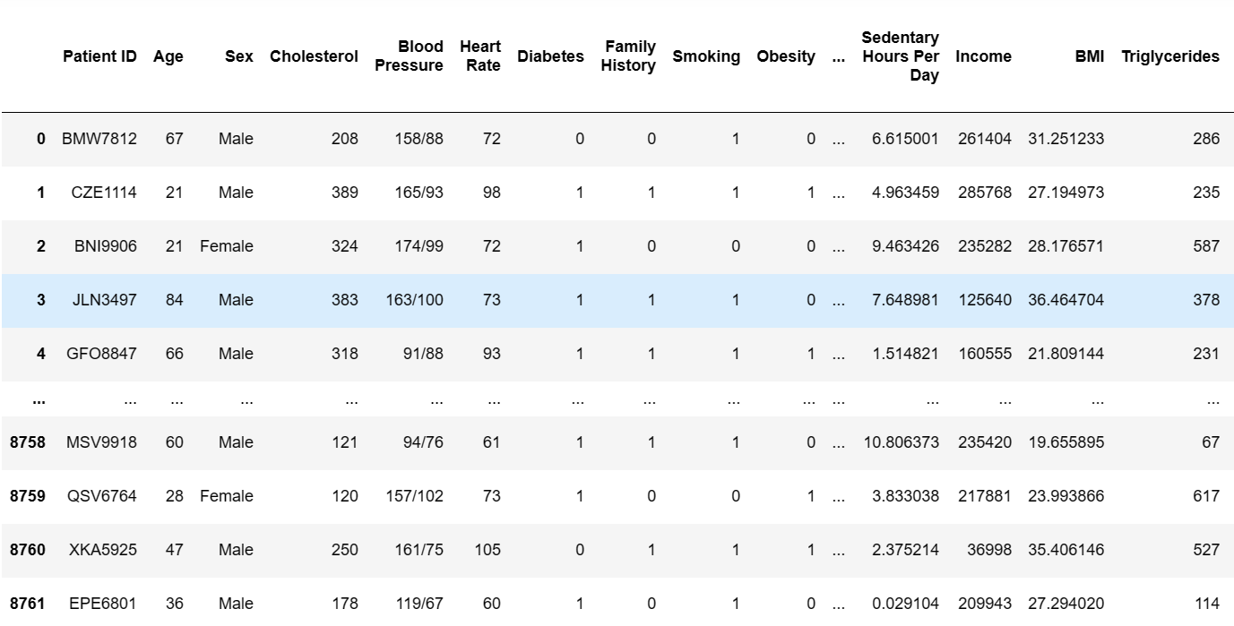
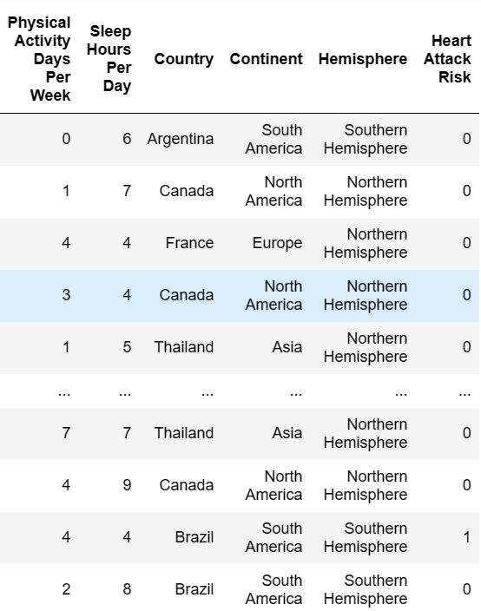
Sample dataset essential attributes for heart disease prediction
Age | Sex | Chest pain (cp) | Resting blood pressure (trtbps) | Cholestoral (chol) | Fasting blood sugar (fbs) | Resting electrocardiographic (restecg) | Maximum heart rate achieved (thalachh) | Exercise induced angina (exng) | Oldpeak | Slope (slp) | Number of major vessels (caa) | Thalium Stress Test (thall) | Output
60 | 1 | 3 | 145 | 233 | 1 | 0 | 150 | 0 | 2.3 | 0 | 0 | 1 | 1
35 | 1 | 2 | 130 | 250 | 0 | 1 | 187 | 0 | 3.5 | 0 | 0 | 2 | 1
41 | 0 | 1 | 130 | 204 | 0 | 0 | 172 | 0 | 1.4 | 2 | 0 | 2 | 1
55 | 1 | 1 | 120 | 236 | 0 | 1 | 178 | 0 | 0.8 | 2 | 0 | 2 | 1
56 | 0 | 0 | 120 | 354 | 0 | 1 | 163 | 1 | 0.6 | 2 | 0 | 2 | 1
55 | 1 | 0 | 140 | 192 | 0 | 1 | 148 | 0 | 0.4 | 1 | 0 | 1 | 1
56 | 0 | 1 | 140 | 294 | 0 | 0 | 153 | 0 | 1.3 | 1 | 0 | 2 | 1

Slide 13
Machine Learning Algorithms
Random Forest Algorithm
Navies Bayes Algorithm
Adaptive Boosting Algorithm
The missing values will be handled by the random forest classifier, which will maintain the detection rate of a large portion of the data.•
The Random Forest is made in two stages: the first is to join N choice trees to make the arbitrary timberland, and second is to make any expectations for each tree created in principal stage.
The Bayes Theorem states that when determining a conditional probability, the final output is determined by each conditional probability.
The classifier make the suspicion of strong, or guileless, liberation between information point credits.
Naive Bayes classifiers have exceptionally good performance on the grounds that they require a bunch of boundaries that is relative to the quantity of characteristics in a learning issue
Adaptive Boosting is a technique in machine learning used as an Ensemble Method.
The most common algorithm used with AdaBoost is decision trees with one level that means with Decision trees with only 1 split.
The weights are re-assigned to each instance, with higher weights assigned to incorrectly classified instances.

Slide 14
Summary
Using these three Machine Learning Algorithm's (Naïve bayes, Random Forest and Adaptive boosting).The goal is to study and merge more datasets in order to create a more relevant dataset that encompasses a broad range of population types. The feature selection can be used to generate more relevant features and effective results for the prediction of heart disease.

Slide 15

Thank you

